Slide 1
2026
Law & Licensure Update
Teri Miller, BPharm, DASPL, J.D. Candidate ’28
Creighton University
TeriMiller@creighton.edu
402-280-2626
CPFI Annual Conference
Saturday, June 6, 2026
9:45AM-10:45AM

Slide 2
Disclosures
Teri Miller declares no conflicts of interest, real or apparent, and no financial interests in any company, product, or service mentioned in this program, including grants, employment, gifts, stock holdings, and honoraria.

Slide 3
Learning Objectives
1. Be aware of changes to the jurisprudence licensure options.
2. Realize that new opportunities exist for poly licensure.
3. Understand the options available for licensure.
4. Be aware of Standard of Care Model and implications for pharmacists.
5. Realize common law implications of recent DEA case.
6. Be aware of the most recent bioethics realities in medicine.

Slide 4
NABP’s Letter to the Deans
April 17, 2026
Graduation List Submission Requirements
Transcript Submission at Graduation
Education Verification Process
Student Responsibilities
Benefits to Schools and Students

Slide 5
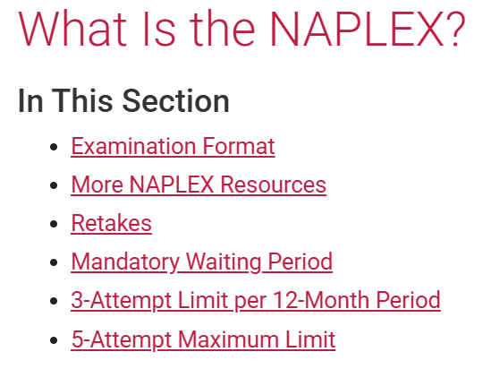
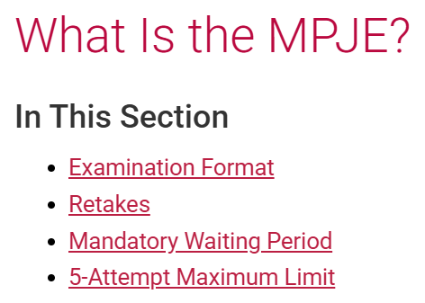
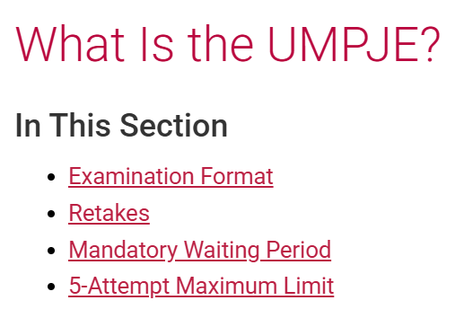
NABP’s Candidate Application Bulletin
Armed Forces Discount, ADA Accommodations, Name Matching Requirements…
Screenshots used with
permission from NABP.

Slide 6
Original Licensure and Licensure by Examination
As a component of initial licensure, or licensure by examination, 45 boards of pharmacy require
passing a law exam administered by NABP. Currently,
most states require the MPJE, but as of April 1, 2026,
several states have begun transitioning to the UMPJE.
Find out which states accept the UMPJE as an early adopter.
The following boards have their own
jurisprudence exam:
Arkansas
California
Nevada
Puerto Rico
The following boards do not require a jurisprudence exam:
Alaska
Idaho
Indiana
Michigan
Vermont
Virgin Islands
If you are seeking licensure in any of these jurisdictions,
contact the board of pharmacy for their requirements.

Slide 7
Uniform MPJE (UMPJE) States
As of April 1, 2026, several states have begun transitioning to the UMPJE.
Find out the details of the states accepting the UMPJE as early adopters.
The following boards are April 1, 2026, early adopters of the UMPJE:
Arizona
Iowa
Kansas
North Carolina
Ohio
Rhode Island
The following boards are June 1, 2026, adopters of the UMPJE:
Florida
Maryland
Montana
Nebraska
Washington**
West Virginia
If you are seeking licensure in any of these jurisdictions,
contact the board of pharmacy for their requirements.
**July 2, 2026

Slide 8
Definition of Standard of Care
The level of care and service that a reasonably competent and skilled health professional, with a similar background and in a similar setting, would have provided under similar circumstances.
It is a benchmark used to measure the quality and appropriateness of the care provided by healthcare practitioners.

Slide 9
Standard of Care Implementation
Iowa was the 3rd state to implement a standard of care framework, following Idaho and Alaska.
Iowa Pharmacy Association is focused on creating educational resources for members and collaborating with the Board of Pharmacy to implement this legislation.

Slide 10
Iowa Code Chapter 155A*
(Pharmacy Practice Act) (HF 555)
Allowed for Therapeutic substitution (e.g. changing atorvastatin 40mg to rosuvastatin 20mg)**
Added “pharmacist” to the definition of “Practitioner” found in Sec. 2 Section 155A.3, subsection 39, Code 2024, effective July 1, 2024. This definition includes prescriptive authority.
Removed 10-mile tele-pharmacy mileage restriction from the nearest community pharmacy
Overall reduction in bright line language
*https://www.legis.iowa.gov/docs/ico/chapter/155A.pdf
**Iowa Pharmacy Association

Slide 11
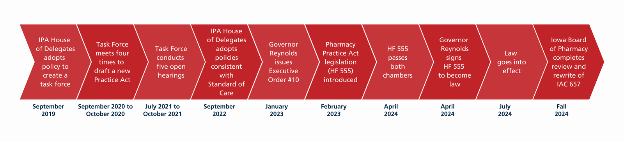
Governor’s Executive Order #10*
*https://governor.iowa.gov/executive-order-number-10

Slide 12
Iowa Administrative Code
Notice of Rule Changes: On May 8, 2025, the Iowa Board of Pharmacy voted to adopt changes to its administrative rules. This action will rescind all current rules under 657 Iowa Administrative Code (IAC) and replace them with new Chapters 550 through 557 under 481 IAC. These changes are part of the Board’s compliance with Governor Kim Reynolds’ Executive Order 10, issued in January 2023.
The adopted rules took effect on or around July 16, 2025.
Iowa Department of Inspections, Appeals, and Licensing

Slide 13
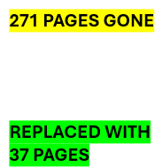
Iowa Administrative Code
Board rules (through July 15, 2025) : 657 IAC
Adopted rules (effective July 16, 2025):
  481 IAC Chapter 550 (Definitions)
  481 IAC Chapter 551 (Licenses, Registrations, and Permits)
  481 IAC Chapter 552 (Standards--Practice of Pharmacy)
  481 IAC Chapter 553 (Controlled and Precursor Substances)
  481 IAC Chapter 554 (Operational Standards--Distribution and Drug Supply Chain)
  481 IAC Chapter 555 (Standards--Drugs in Emergency Medical Services Programs)
  481 IAC Chapter 556 (Iowa Prescription Monitoring Program)
  481 IAC Chapter 557 (Board of Pharmacy Operations)
Iowa Department of Inspections, Appeals, and Licensing

Slide 14
Standard of Care
Benchmark Questions
Is the act expressly prohibited in statute or rules?
Is the act consistent with their education, training, and experience?
Is the act within the accepted standard of care that would be provided in a similar setting by a reasonable and prudent licensee or registrant with similar education, training, and experience?
Iowa Pharmacy Association

Slide 15
What happens if a compliance officer doesn't agree with something we do, even if a large group of reasonably competent pharmacists agree?
The Board of Pharmacy will identify experts and ultimately make the decision. They will use resources from experts in the field, standards across the country and the state of Iowa written by professional associations and other healthcare organizations to determine if something was appropriate. It will not be down to the decision of one person. There is still a process to determine if something was within the standard of care.
Iowa Pharmacy Association

Slide 16
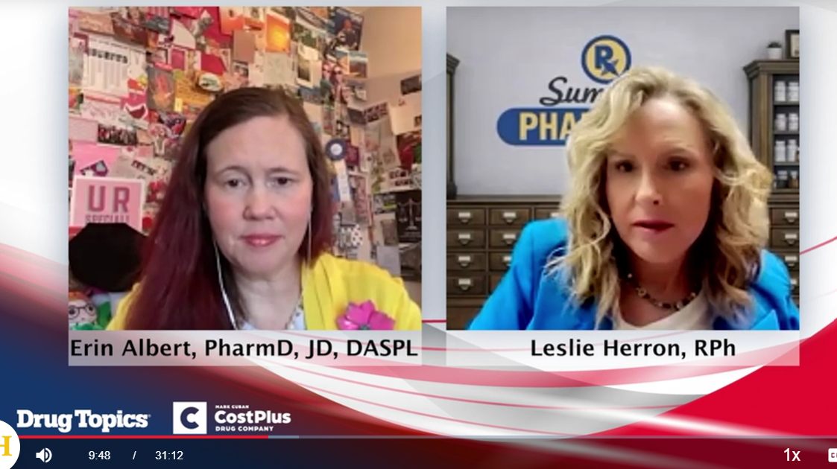
Drug Topics Standard of Care Interview
Click the link above to listen!!
Monica Nikseresht, PharmD. is also leading the way as a 3rd generation RP, owner, and Pharmacy Manager at Medicap Pharmacy, Glenwood, IA….

Slide 17
Cicero Institute*
nonpartisan public policy organization
staffed by thinkers with deep experience in government, legislation and the law, technology, and entrepreneurship
develop and fight for bold policies at the state level that restore liberty, accountability, and transparency in American governance
Advocate for and define Pharmacist Full Practice Authority
*https://ciceroinstitute.org/

Slide 18
Neumann’s Pharmacy, L.L.C. v. DEA
United States Court of Appeals for the Fifth Circuit
February 13, 2026
DEA revoked a LA pharmacy’s registration for 3 “red flags”
    Drug cocktail, Therapeutic duplication, Self-pay
DEA claimed that the RP violated DEA regulations; RP contended that the DEA misinterpreted its own regulations.
RP consulted prescribers and documented.
Court said that the DEA finding a violation “without first determining that any Rx was invalid when issued” is a misapplication.
Corresponding responsibility applies to RP ONLY if 3 elements are met:
    RP fills
    An invalid prescription
    KNOWINGLY
Ruling places liability on RPs only when an order for a controlled substance is invalid. It may be the precedent, if followed, that relieves RPs from legal action due to “red flags.”

Slide 19


BioEthics Current Events
Thaddeus Daniel Pierce* Nash Keen**
Born July 26, 2025 Born July 5, 2025
Embryo Cryogenically Stored >30 years World' s Most Premature Baby
*MIT Technology Review
**https://uihc.org/ (link above)

Slide 20

It’s Kahoot! Time….
QR Code Coming…
This Photo by Unknown Author is licensed under CC BY-NC-ND

Slide 21
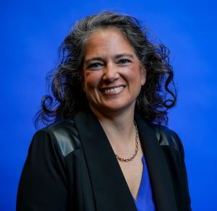
Questions??
Teri Miller, BPharm., DASPL II, J.D. Candidate ‘28
  Assistant Clinical Professor of Pharmacy Practice
  Licensure Specialist, Pharmacy Practice Law
  Office of Experiential Education
  Office: Hixson Lied Science Building Room 139
  Phone: 402-280-2626
  terimiller@creighton.edu

